Slide 1
Indian Equity Market Sector Analysis
Data-Driven Market Insights and Sector Performance
Divya M

Slide 2
Introduction
Project Overview: This project analyzes the performance of 14 major Indian companies across 8 sectors.
Objective: To identify high-liquidity opportunities, assess sector-wise performance, and categorize market risk through volatility analysis.
Scope: Transitioning from fragmented raw stock data to an interactive business intelligence tool.
Source: Kaggle dataset

Slide 3
Problem statements
1.Show overall market trading summary.(KPI summary)
2.Top 5 highly liquidity stock.
3.Track monthly volume changes.
4. Compare trade value by market cap.
5.Compare trades across market caps.
6.Show volatility level distribution.
7.Identify profit/loss sectors.
8. Find top trading sectors.
9. List best performing stocks.

Slide 4
Technology Used
Power BI Desktop: For data modeling and advanced visualization.
Power Query (M Language): For ETL (Extract, Transform, Load) processes.
DAX (Data Analysis Expressions): For calculating complex KPIs like Alpha, Total Volume, and Sector Returns.
Excel: For initial data staging and final report export.

Slide 5
01
Data Transformation Steps (Power Query – Power BI)
1. Data Import
Imported the original dataset Stock Market into Power BI Power Query Editor.
2. Company-wise Data Filtering
Filtered each company separately.
Created individual tables for every company stock data.
3. Date Cleaning
Removed unwanted date records.
Deleted 2022 data because it contains only one record (Dec 31) and is incomplete.

Slide 6
01
Data Transformation Steps (Power Query – Power BI)
4. Duplicate Removal
Checked and removed duplicate rows for all company stock tables.
Ensured only unique trading records were retained.
5. Data Appending
Used Append Queries to combine all individual company tables into one single consolidated table.
6. Final Dataset Creation
Verified the cleaned and appended dataset.
Exported the final combined dataset into Excel as “Stock Data” (second file).

Slide 7
Data Modeling
Schema: Implemented a Star Schema for optimal performance.
Fact Table: Master Stock Data
Dimension Tables: Sector, and Company Type
Relationships: Established 1-to-Many relationships to enable cross-filtering between sector, year, and stock name.

Slide 8
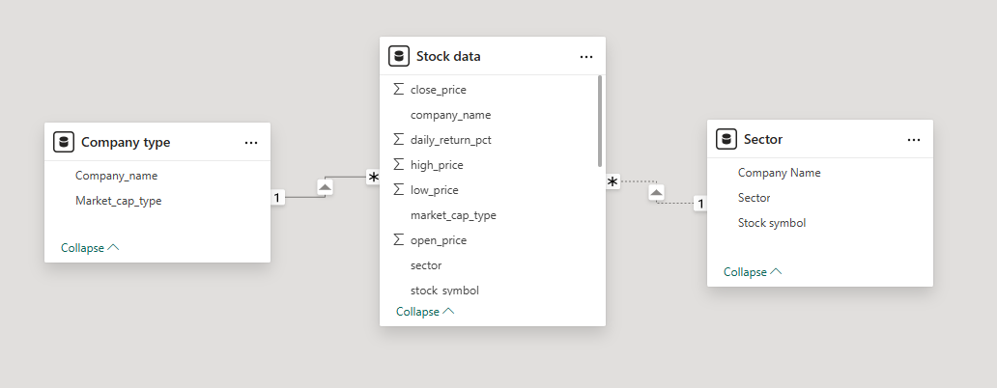
Data Modeling in Power BI- Star schema

Slide 9
DAX Measure
Total Trade Volume
Total Trade Value
Average Trade volume
Average Return
Company Average Return
Sector Average Return
Alpha

Slide 10
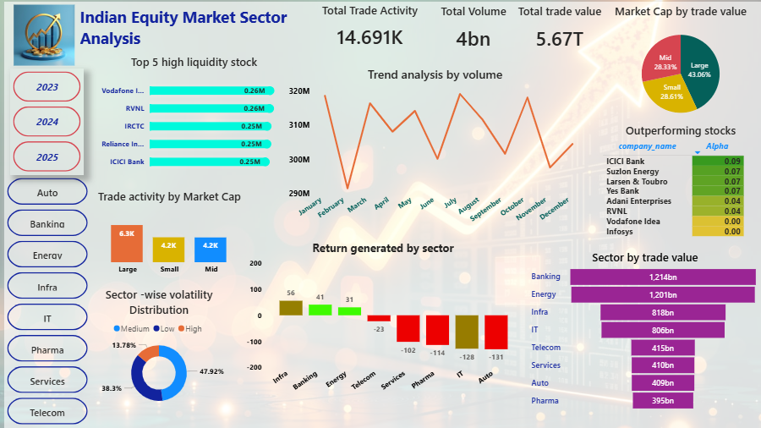
Indian Equity Sectors Analysis Dashboard

Slide 11
KPI Summary
Trade activity: 14.691K (Unique, cleaned trades).
Total Volume: 4 Billion (Total shares exchanged).
Total Trade Value: ₹5.67 Trillion (Total cash flow tracked).
Key Takeaway: The market shows a high density of trading activity in the Large-cap segment despite having a diverse range of companies.

Slide 12

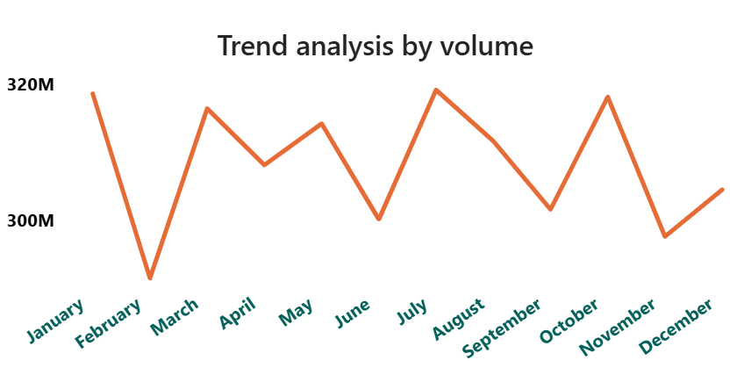
Trend Analysis by Volume
Problem Statement: Is market interest growing or dying down over the year?
Data Used: Time (Months) and Total Trading Volume.
A Line Chart is the gold standard for "time-series" data. It highlights peaks (August) and troughs (February) to show seasonality.
Insight: There is a massive surge in volume during July/August and October, indicating "earnings season" or major policy shifts during those months.

Slide 13
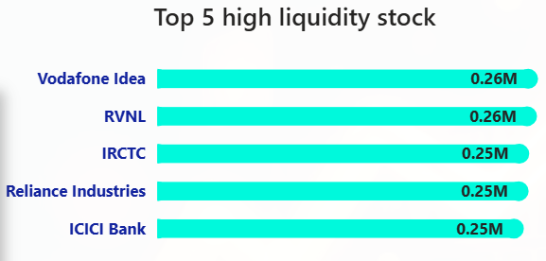
Top High Liquidity Stocks and Implications
Problem Statement: Which stocks are the easiest to buy and sell right now?
Data Used: Individual Stock Names and Trading Volume (in Millions).
A Horizontal Bar Chart is best for ranking. It allows for long company names to be read easily while showing the gap between the #1 and #5 spots.
Insight: Vodafone Idea and RVNL are leading the market in activity, suggesting high retail interest or news-driven trading.

Slide 14
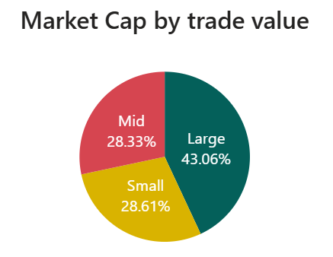
Market Cap by Trade Value
Problem Statement: Where is the most money being spent: Big, Medium, or Small companies?
Data Used: Market Cap category and % Share of Total Value.
A Pie Chart effectively shows "parts of a whole." It answers: "Does one segment dominate the entire market's wallet?"
Insight: Large-cap stocks command nearly half (43%) of the market's money, showing that investors still prefer safety over high-risk small caps.

Slide 15
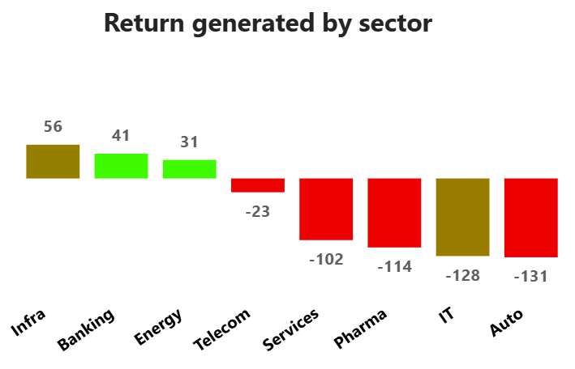
Return Generated by Sector
Problem Statement: Which industries are making money and which are losing it?
Data Used: Sector Names and Daily Returns percentage
A Diverging Bar Chart (with a center zero line) is perfect for showing profit vs. loss. Red bars pointing down immediately signal trouble.
Insight: Infrastructure and Banking are the "engines" of growth, while Auto and IT are currently in a significant downturn.

Slide 16
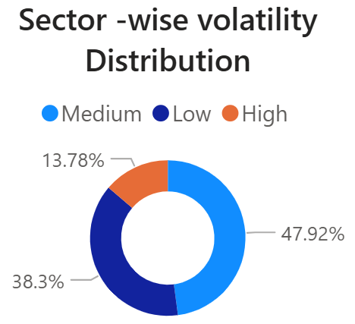
Sector Volatility Distribution
Problem Statement: How "bumpy" or risky is the current market?
Data Used: Risk levels (Low, Medium, High) based on price swings.
A Donut Chart provides a modern look at proportions while leaving the center open for a "total" summary or a clean visual break.
Insight: The market is dominated by Medium to High volatility (blue and orange sections), suggesting a "Trader's Market" rather than a stable "Investor's Market."

Slide 17
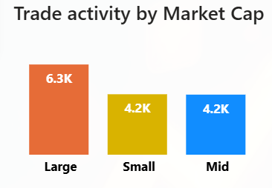
Trading activity by Market Cap
Problem Statement: Is the market "busy" with many small trades or "heavy" with few big trades?
Data Used: Market Cap category and Count of Trades (Frequency).
A Grouped Column Chart allows for a quick side-by-side comparison of volume versus frequency.
Insight: Large caps have the highest trade count (6.3K), confirming they are the most liquid and active segment for all types of investors.

Slide 18
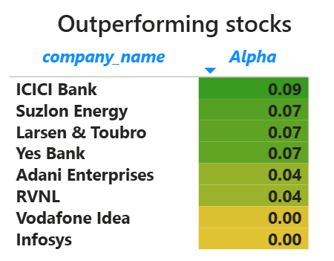
Outperforming Stocks (Alpha)
Problem Statement: Which specific stocks are beating the average market return?
Data Used: Company Name and Alpha Score (Relative outperformance).
A Heatmap/Table is used because the exact number (e.g., 0.09) matters more than a visual bar. The green color-coding instantly tells the eye who the "winners" are.
Insight: ICICI Bank and Suzlon are the top "Alpha" generators, meaning they are providing better returns than the general index.

Slide 19
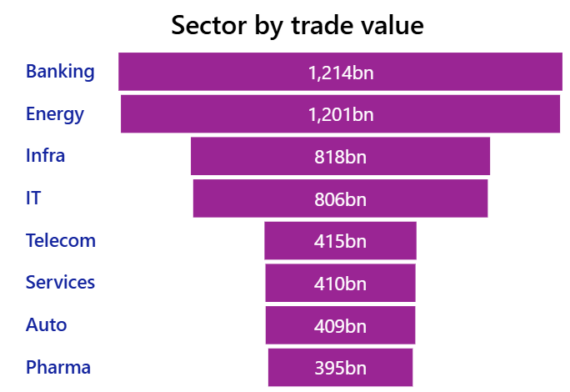
Sector by Trade Value
Problem Statement: Which sectors have the most cash flowing through them?
Data Used: Sector Names and Total Value in Billions (bn).
A Funnel/Sorted Bar Chart helps prioritize. It shows the "heavyweights" at the top so you know where the most liquidity resides.
Insight: Banking and Energy are the most "liquid" sectors (over 1,200bn each), making them the safest bet for large institutional entries.

Slide 20
Final Outcome
Prepared a clean consolidated dataset suitable for reporting and analysis.
Built an interactive Power BI dashboard with slicers for Year and Sector.
Created KPIs to summarize market performance quickly.
Designed charts to highlight liquidity, sector performance, volatility, and market cap impact.
Enabled identification of top-performing stocks and high-trade sectors.

Slide 21
Conclusions
Market analysis reveals investor concentration in large-cap stocks with significant trading activity and market value. Medium to high volatility conditions create dynamic trading environments, favoring active market participants. Sector performance varies widely, with Banking and Infrastructure leading growth, underscoring the importance of sectoral diversification and careful risk management.
This project successfully transformed raw stock market data into a structured format and developed a Power BI dashboard for equity analysis. The dashboard provides meaningful insights into market trends, sector contributions, volatility distribution, and top-performing stocks. This analysis supports better decision-making for investors and helps in understanding market behavior.

